Slide 1
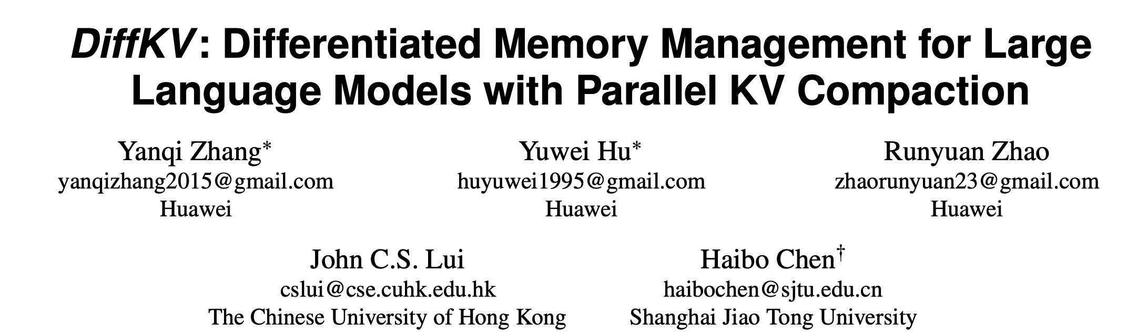
SOSP’25

Slide 2
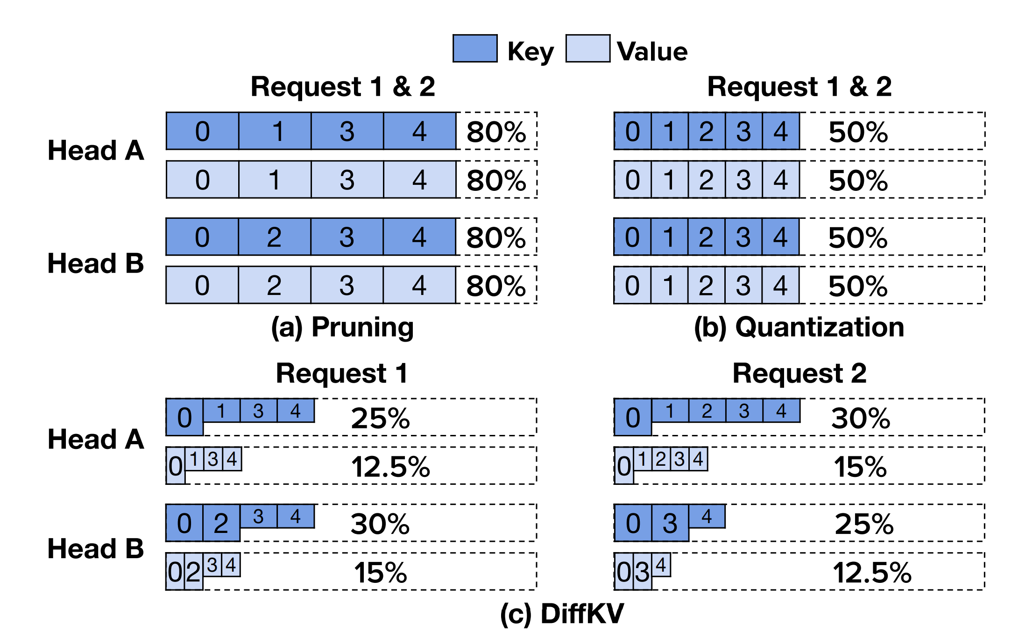
KV Cache Compression
Keys and Values
Tokens
Per-head
Fine grained
On-GPU memory management for low overhead

Slide 3
KV Cache Compression
Fine grained
On-GPU memory management for low overhead
New data-structures on GPU that allow parallel (across heads) KV compaction

Slide 4
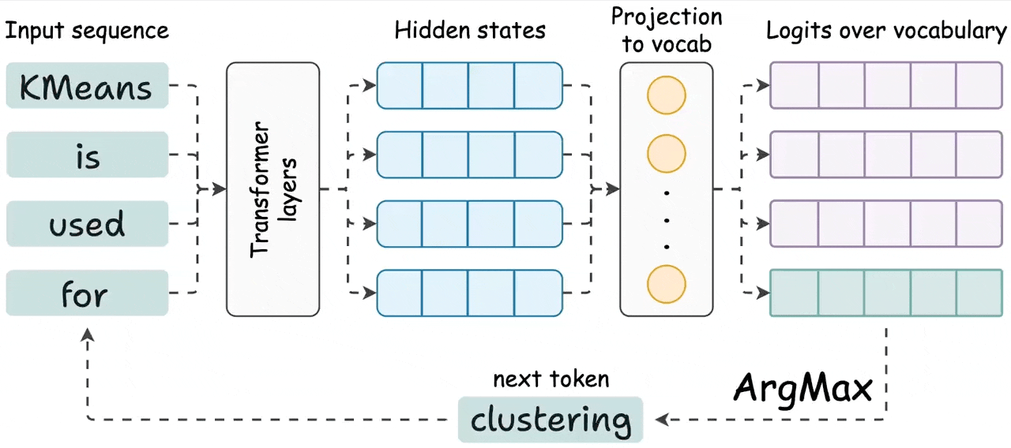
Background -- transformer

Slide 5
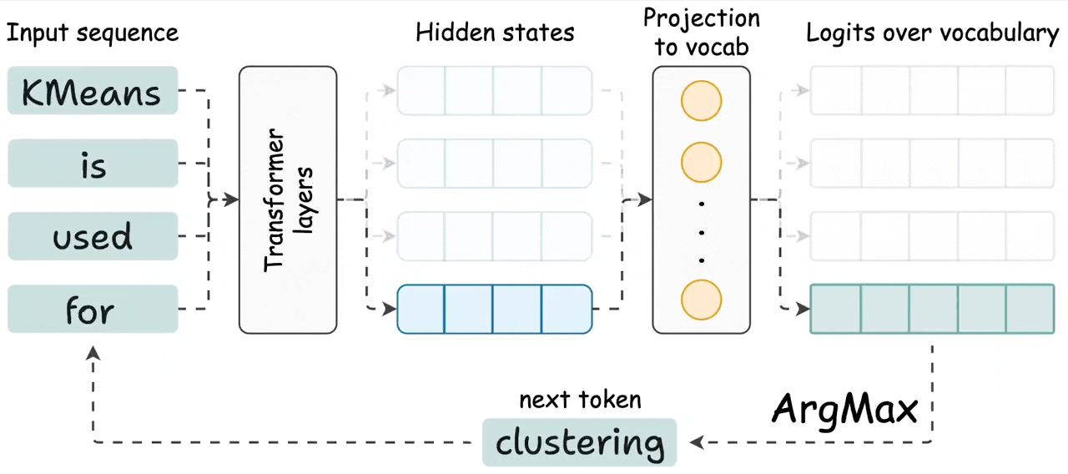
Background -- transformer

Slide 6
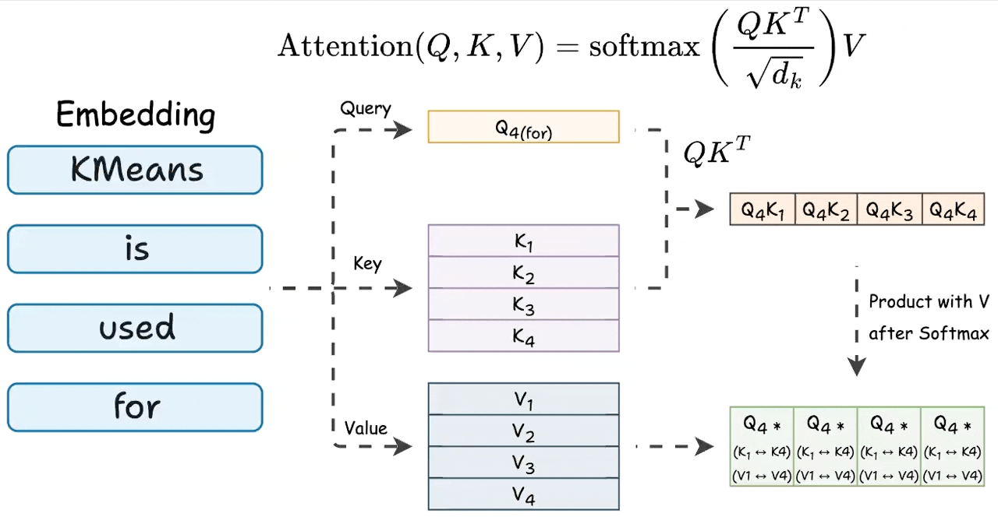
Background -- KV Cache

Slide 7
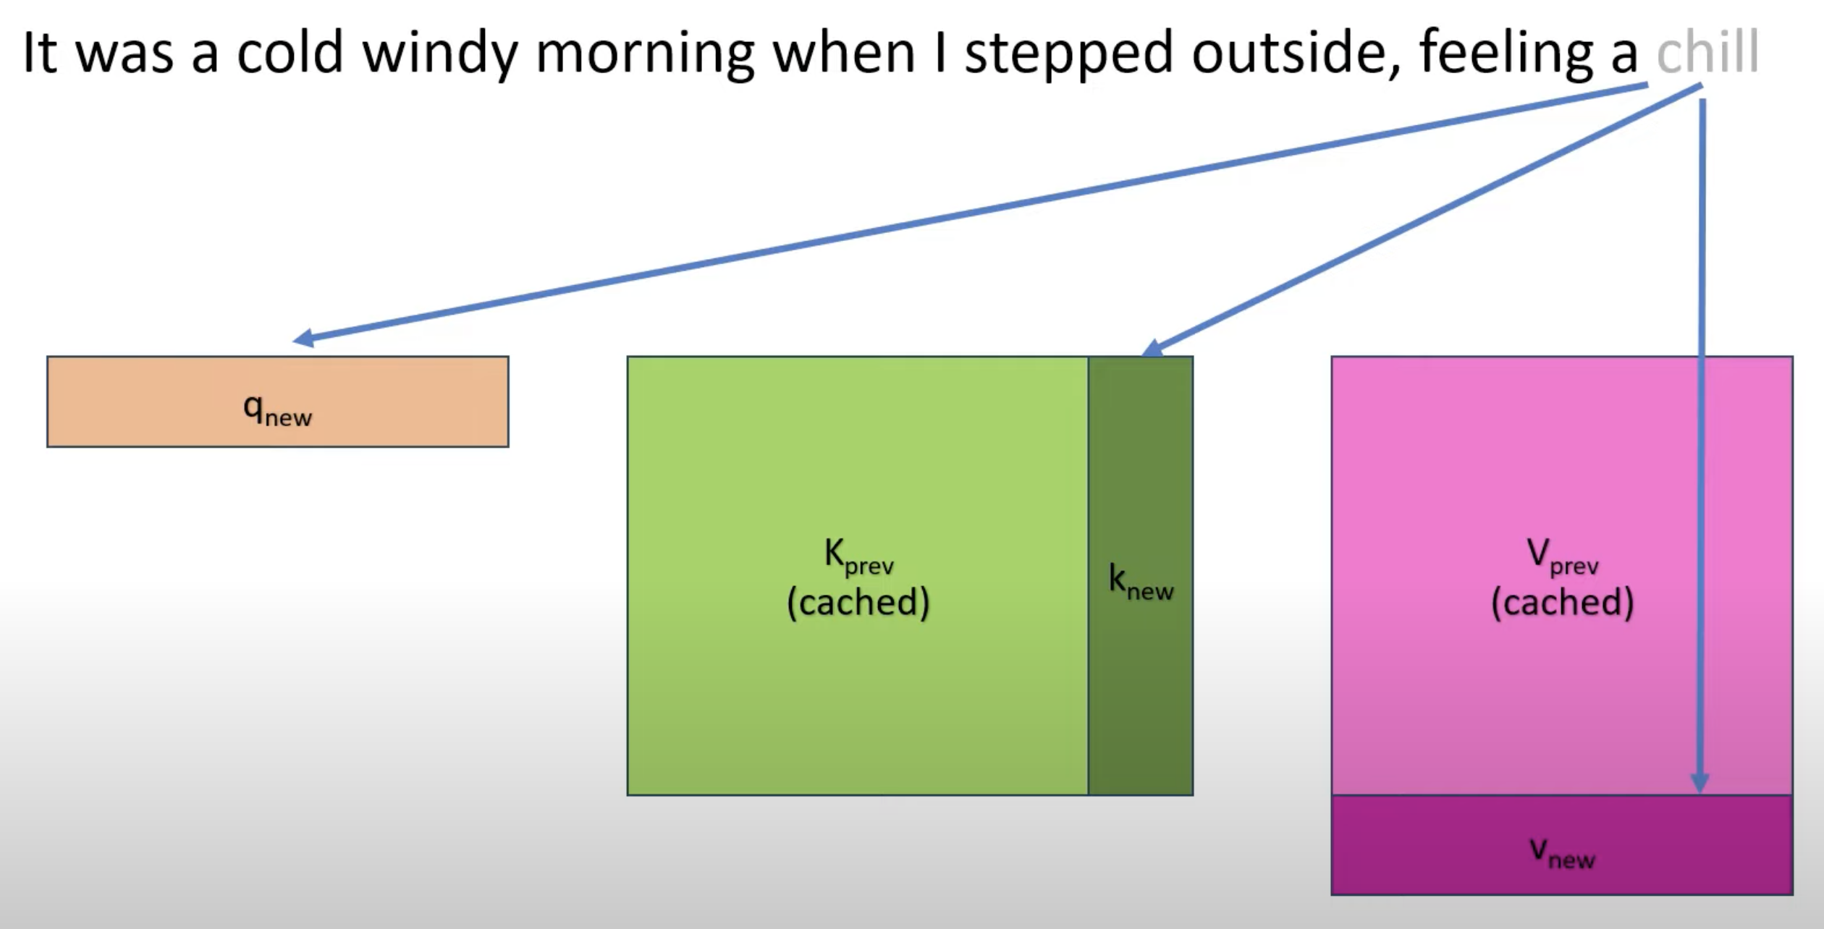
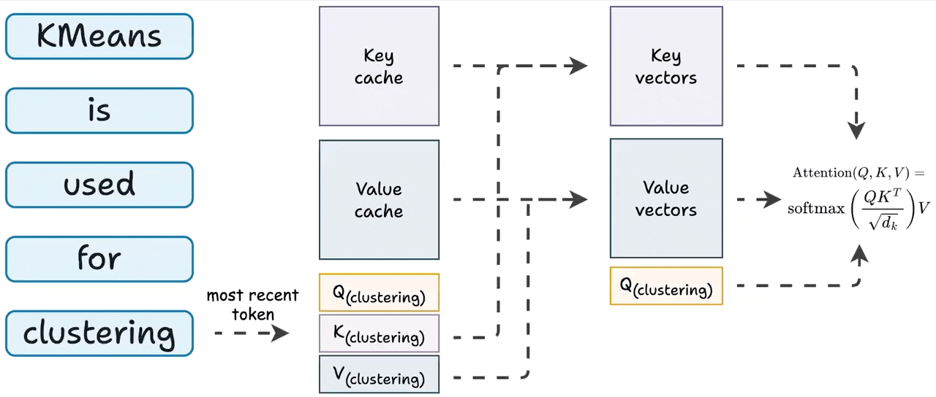
Background -- KV Cache

Slide 8
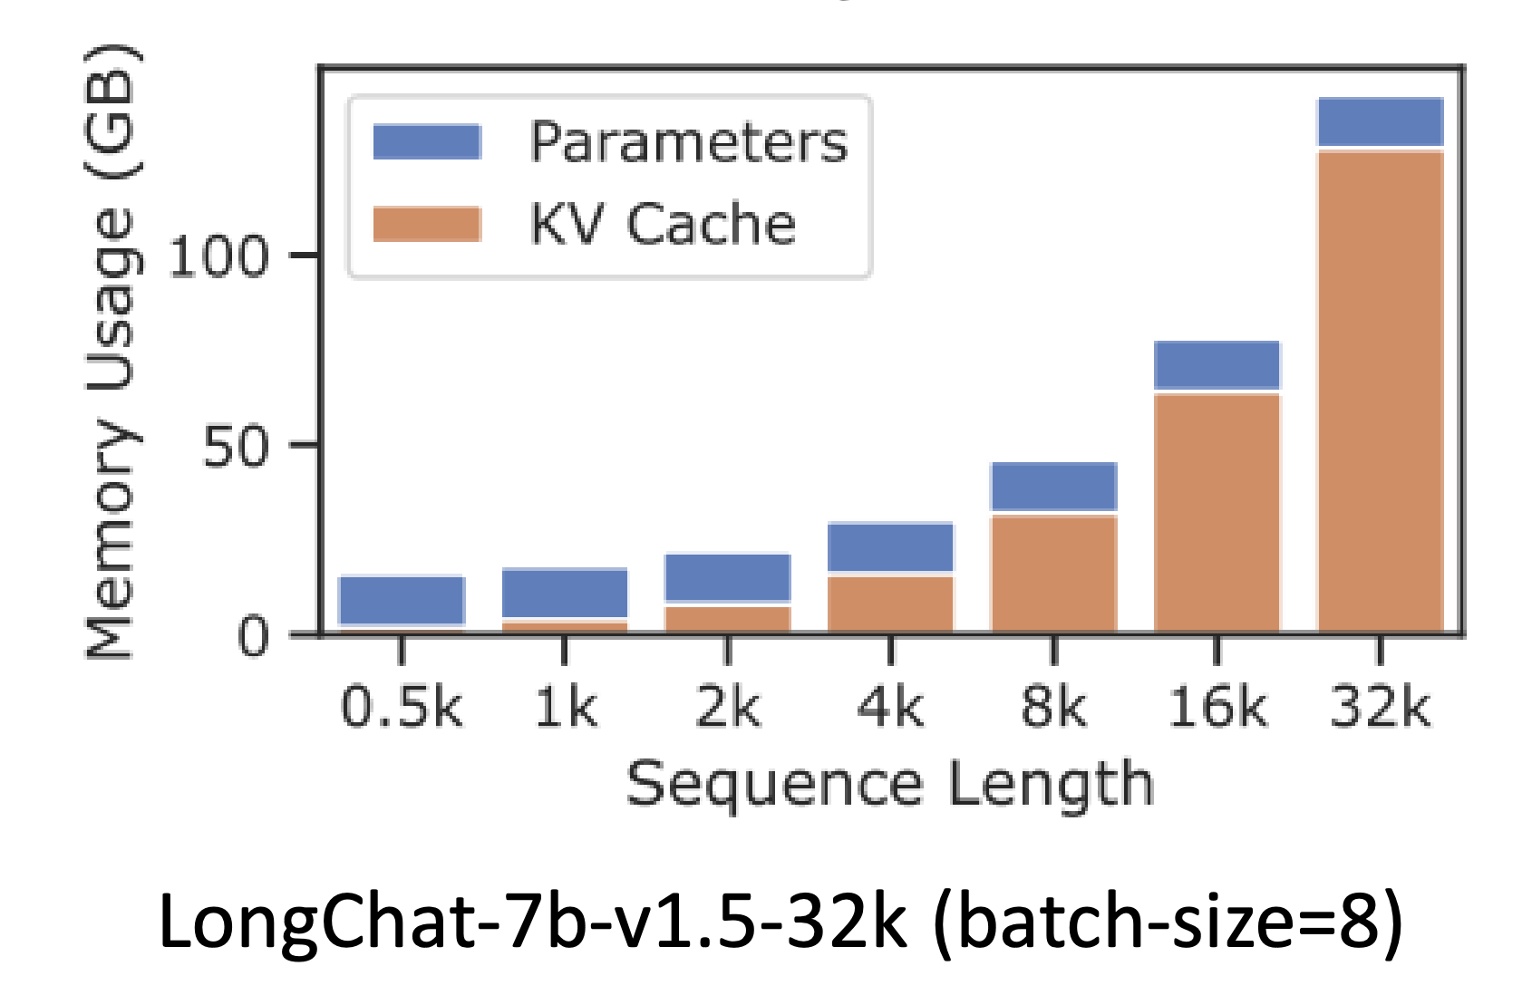
Background -- KV Cache
In Llama3-70B, every token takes up to ~2.5MB in the KV cache
4k tokens (the max output size) will take around 10.5 GB
This cache is huge!
Notes:
A top of line programmable switch has 10s of MBs of SRAM.

Slide 9
Background -- KV Cache Naïve Allocation
For each incoming request, allocate memory equal to what would be needed for the maximum sequence length
Because standard attention computation requires all K and V to be present in memory in contiguous chunks
Wastes huge amount of memory
Fragmentation
Some estimates say almost 80% memory goes unused
Notes:
A top of line programmable switch has 10s of MBs of SRAM.

Slide 10
Background -- KV Cache Paged
PagedAttention, a new attention computation mechanism
Does not require all KV to be present in a single (contiguous) chunk
Can work with KV present in several chunks
Computes block/chunk wise attention
This allows KV cache to be stored in non-contiguous memory
OS-virtual-memory like paging is introduced to the KV cache
Notes:
A top of line programmable switch has 10s of MBs of SRAM.

Slide 11
Background -- KV Cache Pruning
Use attention scores of tokens to find critical and non-critical tokens
Drop non-critical tokens’ KV and suffer a little bit in the output
Notes:
A top of line programmable switch has 10s of MBs of SRAM.

Slide 12
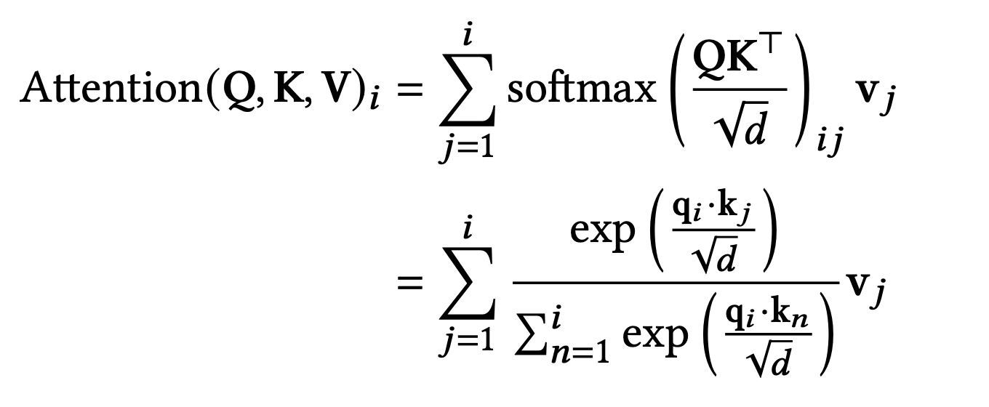
Case for Differentiation – Keys and Values
Keys affect all tokens, Values affect respective tokens
So, keys have higher significance than values

Slide 13
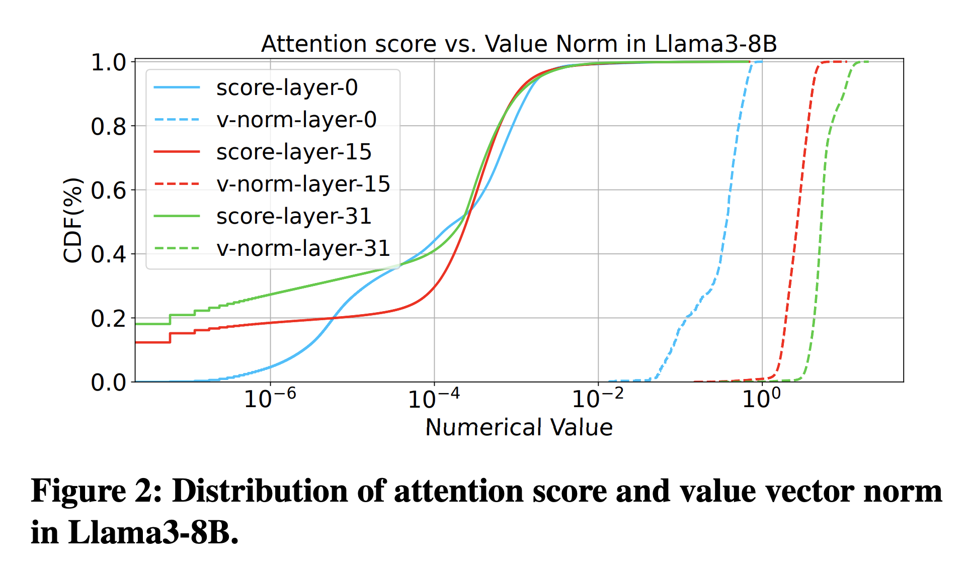
Case for Differentiation – Keys and Values
Value vectors’ magnitudes span a shorter range of values than the overall attention scores’ values
So value vectors don’t need a huge range – can be quantized aggressively
Empirically, K8V4 (K4V2) outperform K4V8(K2V4)

Slide 14
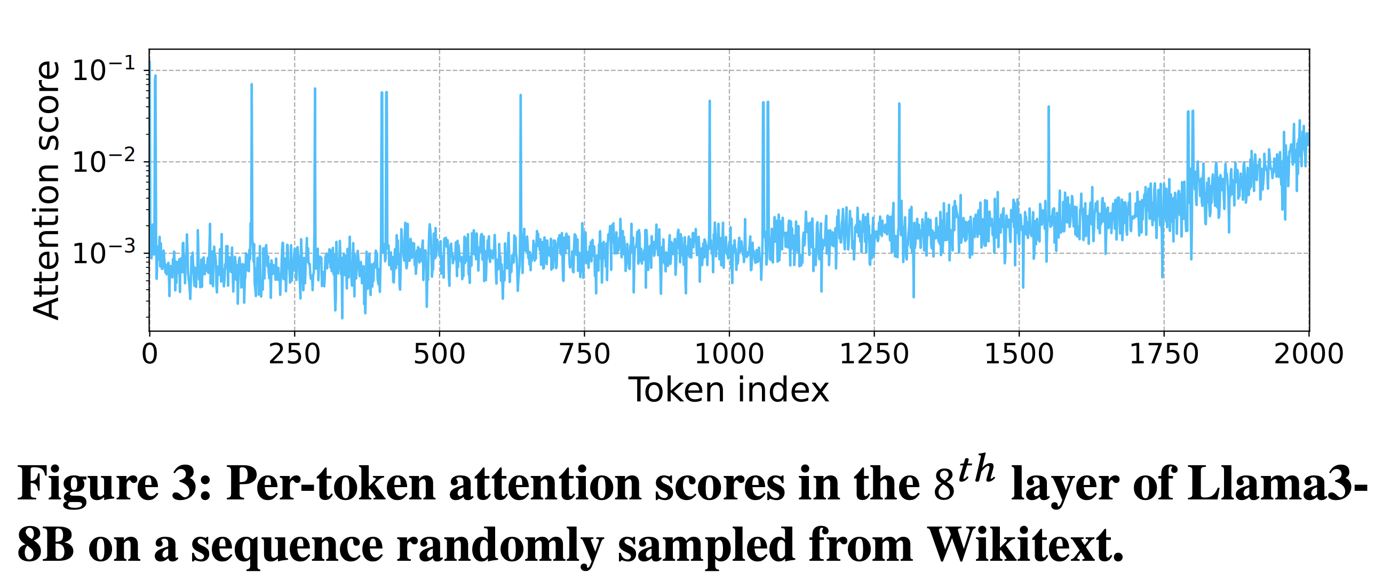
Case for Differentiation – Tokens
Some tokens contribute more to the output than other tokens
Relative to the attention scores of tokens
Notes:
Three classes, high precision, low precision, prune How are positions handled, I thought position information is baked into the values

Slide 15
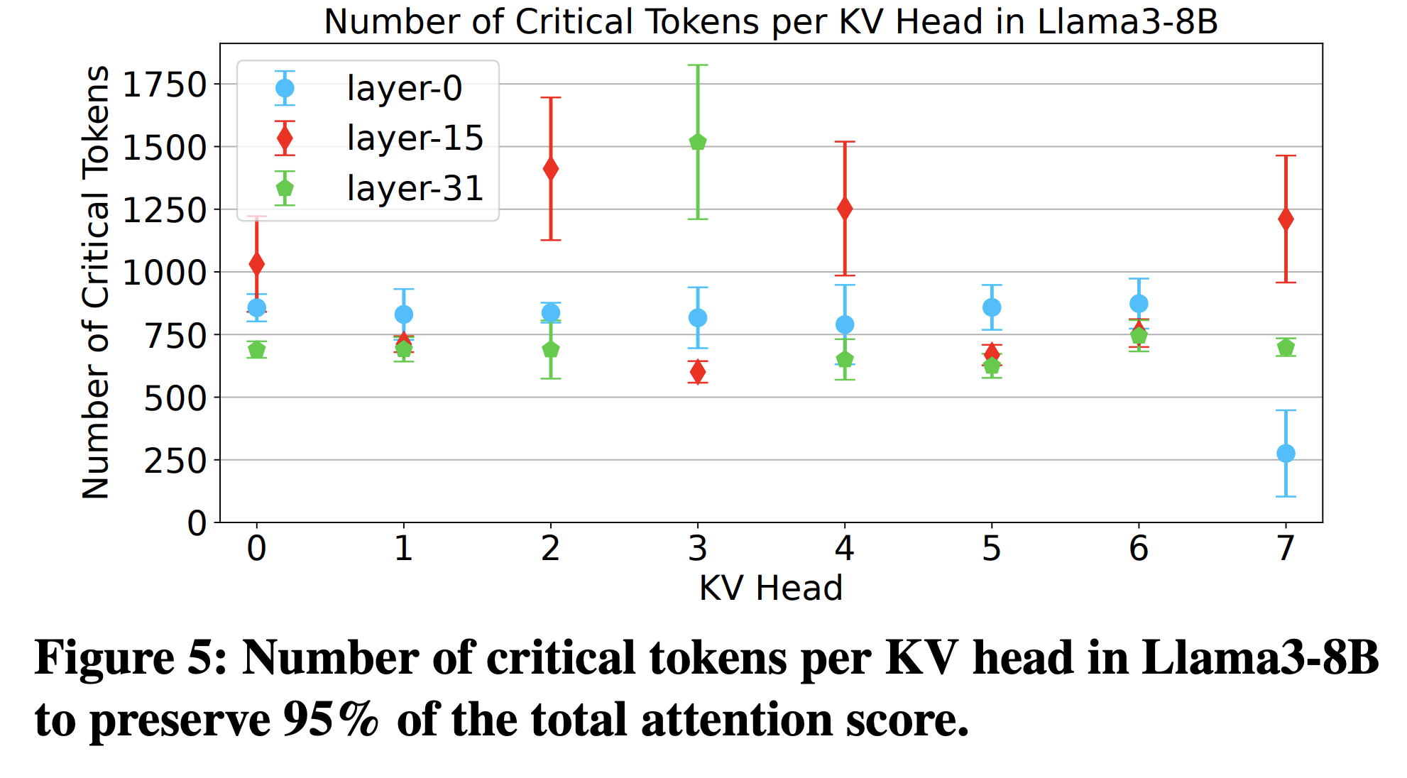
Case for Differentiation – Heads
LLMs exhibit dynamic sparsity patterns that vary across both attention heads and requests
Number of critical tokens vary across heads as well across requests for the same head
Notes:
The spread is the standard deviation calculated across requests

Slide 16
KV Compression Policy
Keys use higher precision than values
K8V4 or K4V2
Each token’s significance is calculated and classified as, (i) most significant, (ii) moderately significant or (iii) least significant
Most significant use K8V4
Moderately significant use K4V2
Least significant are dropped
Each head is allowed to determine its memory requirements dynamically (i.e., the memory management unit is designed to allow that)

Slide 17
KV Compression Policy – Prompt Phase
K and V is calculated for all tokens in the prompt
Significance is calculated for each token
Average the attention scores it receives from the subsequent tokens
Compare significance score of i-th token to the theoretical average 1/i.
If score exceeds h/i → high precision
If score exceed l/i → low precision
Otherwise → drop the token
Notes:
Shouldn’t it be 1/N. it should be I guess.

Slide 18
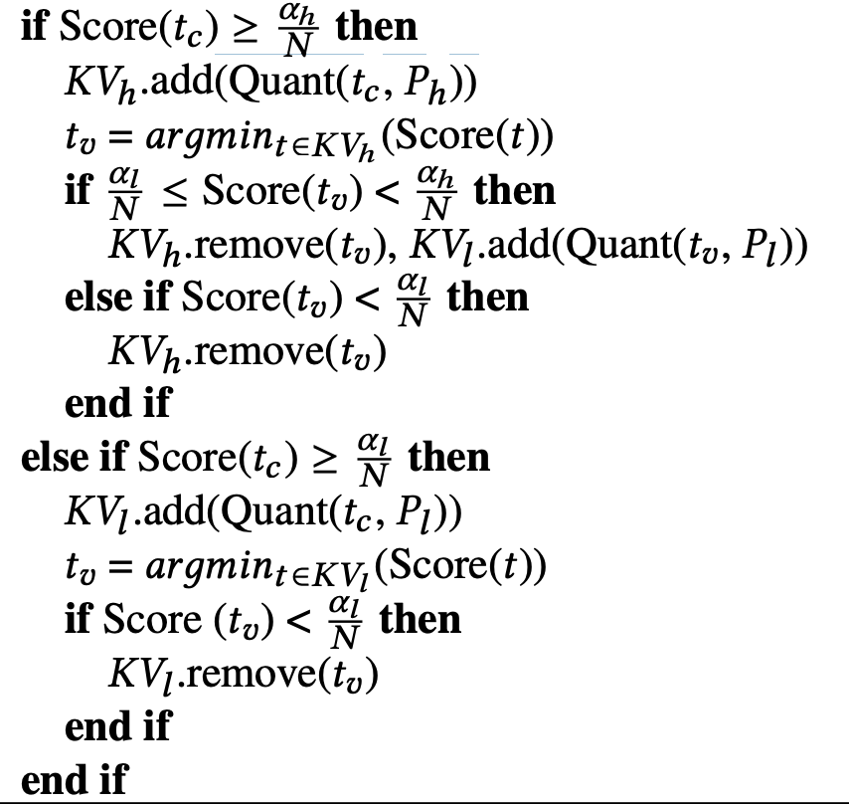
KV Compression Policy – Generation Phase
Notes:
Shouldn’t it be 1/N. it should be I guess.

Slide 19
Memory Management -- Challenges
Differentiation at varying levels does not lend us the simplicity of having uniform memory pages
Rule of thumb for simplicity: you should be able to calculate index of a word/item given the address of a page and size of words
Mixing varying size words in a single page takes away that simplicity
How about we pad K4V2 to behave like K8V2 → memory wastage
Memory management metadata increases as we have several levels of precisions, potentially different precision for different heads

Slide 20
Memory Management -- Design
Goal: Allow fast KV compaction → Parallel KV compaction
Parallel across heads
Proposes simple data structures for memory management that allows each head to do its own memory management efficiently while synchronizing across whenever required to contain the amount of metadata

Slide 21
Memory Management – Design
Unified Pages:
One page only handles one precision level (i.e., K8V4 or K4V2)
Each page stores all the information required to compute attention of the keys and values stored in the page i.e., precision related metadata, significance scores etc.
This avoids several scattered lookups while attention computation

Slide 22
Memory Management – Design
Circular Free Page List
Maintains all Page IDs in a circular list
All free page IDs are contiguous and all non-free are contiguous
Single head and single tail pointer
Head pointer advances to make an ID non-free
Tail pointer advances to make and ID free
In the beginning, each head gets ownership of an exclusive sublist from which they allocate their pages

Slide 23
Memory Management – Design
Bidirectional Page Table
A page table for each attention head
Mapping from request ID to list of page IDs
The value (list of Page IDs) in the table is a bidirectional list
High precision pages grow from one side and the low precision pages grow from the other side
The size of the list is conservatively set to be high so that overflow does not occur (does not lead to noticeable overhead)

Slide 24
Workflow
Prompt phase
Planning phase = allocation of pages
Coordination phase = potential freeing of pages
Generation phase
No freeing needed here, only allocation may happen

Slide 25
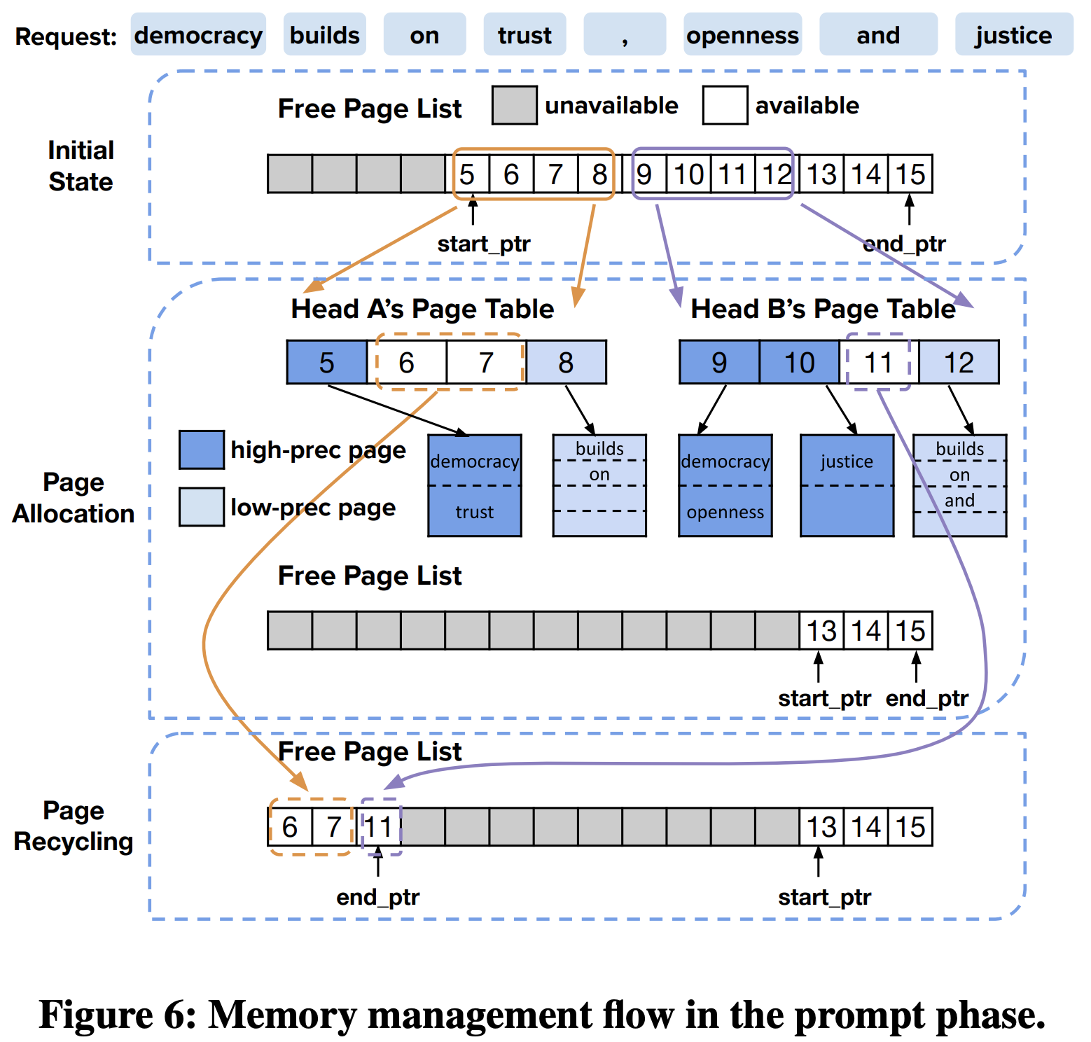
Workflow – Prompt Phase

Slide 26
Workflow – Generation Phase
Only more allocation may happen so each head may need 0 or 1 new pages
As the list of free pages is contiguous, a parallel prefix sum algorithm can be used to find non-overlapping indices for each head efficiently.
At the end of a request, all pages are freed.

Slide 27
Custom Kernel
One head per one thread block
One page per warp at a time
Reduction over feature dimension (for q.k)
Reduction over token dimension (weighted sum of v)
Different layouts for each type of reduction to avoid scattered memory lookups
To avoid work imbalance across warps
Warps iterate over high precision pages first and then low precision pages
As opposed to assigning a static list of pages to each warp.

Slide 28
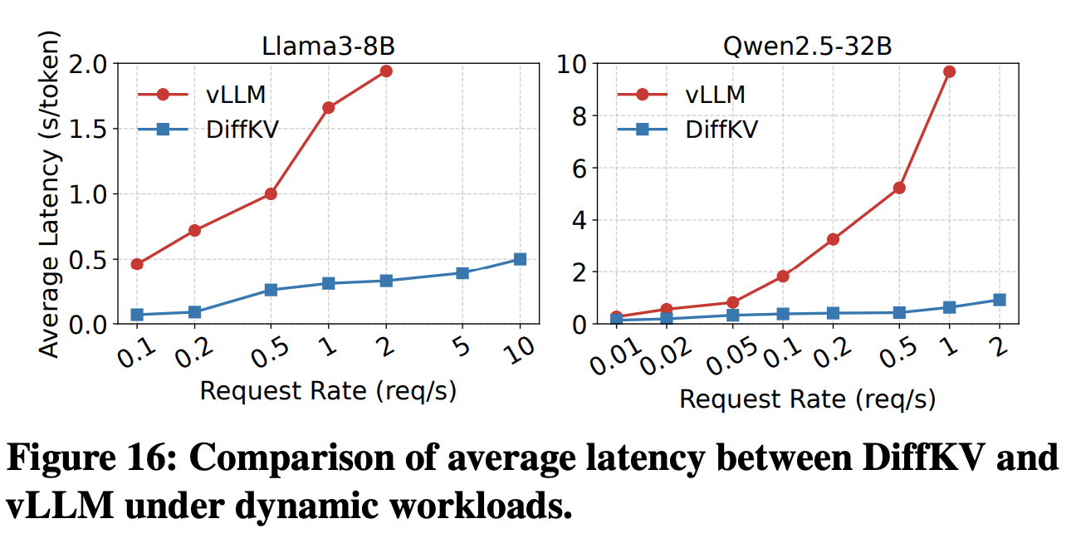
Evaluation

Slide 29
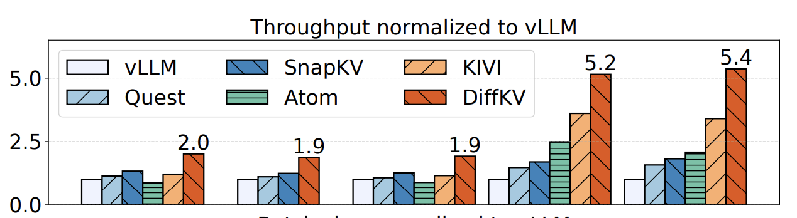
Evaluation

Slide 30
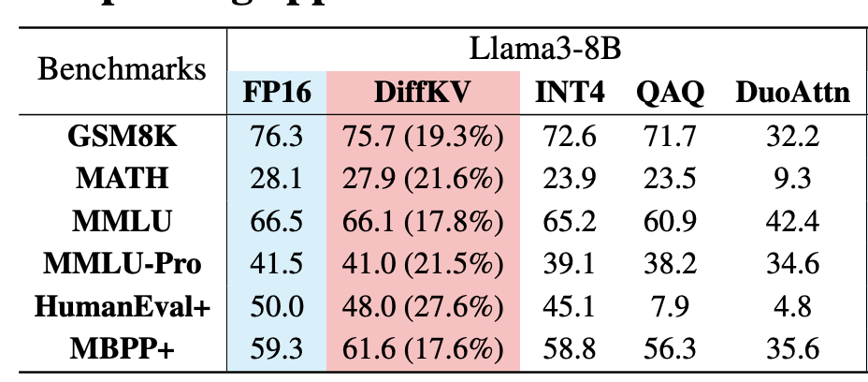
Evaluation

